Slide 1
GEE and Mixed Models for longitudinal data
Kristin Sainani Ph.D.
http://www.stanford.edu/~kcobb
Stanford University
Department of Health Research and Policy
Notes:
Kristin Sainani Ph.D.
http://www.stanford.edu/~kcobb
Stanford University
Department of Health Research and Policy

Slide 2
Limitations of rANOVA/rMANOVA
They assume categorical predictors.
They do not handle time-dependent covariates (predictors measured over time).
They assume everyone is measured at the same time (time is categorical) and at equally spaced time intervals.
You don’t get parameter estimates (just p-values)
Missing data must be imputed.
They require restrictive assumptions about the correlation structure.

Slide 3
Example with time-dependent, continuous predictor…
6 patients with depression are given a drug that increases levels of a “happy chemical” in the brain. At baseline, all 6 patients have similar levels of this happy chemical and scores >=14 on a depression scale. Researchers measure depression score and brain-chemical levels at three subsequent time points: at 2 months, 3 months, and 6 months post-baseline.
Here are the data in broad form:
id time1 time2 time3 time4 chem1 chem2 chem3 chem4
1 20 18 15 20 1000 1100 1200 1300
2 22 24 18 22 1000 1000 1005 950
3 14 10 24 10 1000 1999 800 1700
4 38 34 32 34 1000 1100 1150 1100
5 25 29 25 29 1000 1000 1050 1010
6 30 28 26 14 1000 1100 1109 1500

Slide 4
Turn the data to long form…
data long4;
set new4;
time=0; score=time1; chem=chem1; output;
time=2; score=time2; chem=chem2; output;
time=3; score=time3; chem=chem3; output;
time=6; score=time4; chem=chem4; output;
run;
Note that time is being treated as a continuous variable—here measured in months.
If patients were measured at different times, this is easily incorporated too; e.g. time can be 3.5 for subject A’s fourth measurement and 9.12 for subject B’s fourth measurement. (we’ll do this in the lab on Wednesday).

Slide 5
id time score chem
1 0 20 1000
1 2 18 1100
1 3 15 1200
1 6 20 1300
2 0 22 1000
2 2 24 1000
2 3 18 1005
2 6 22 950
3 0 14 1000
3 2 10 1999
3 3 24 800
3 6 10 1700
4 0 38 1000
4 2 34 1100
4 3 32 1150
4 6 34 1100
5 0 25 1000
5 2 29 1000
5 3 25 1050
5 6 29 1010
6 0 30 1000
6 2 28 1100
6 3 26 1109
6 6 14 150
Data in long form:

Slide 6
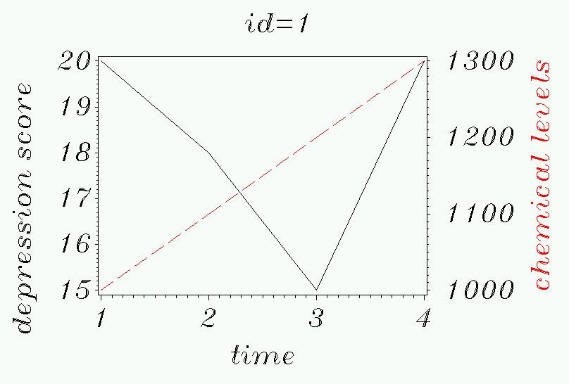
Graphically, let’s see what’s going on:
First, by subject.

Slide 7
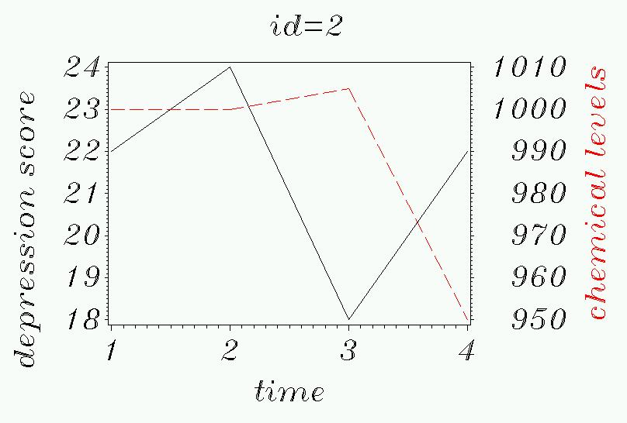

Slide 8
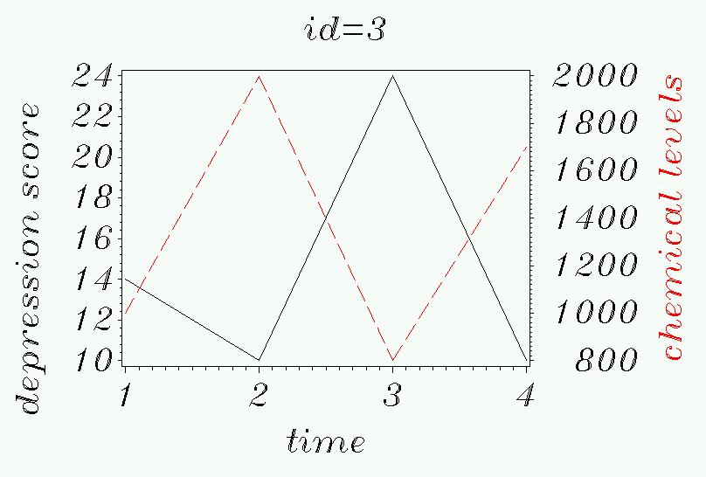

Slide 9
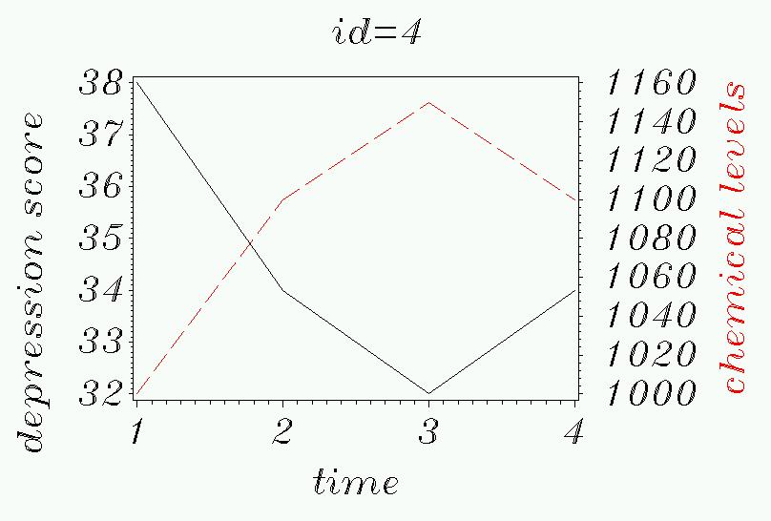

Slide 10
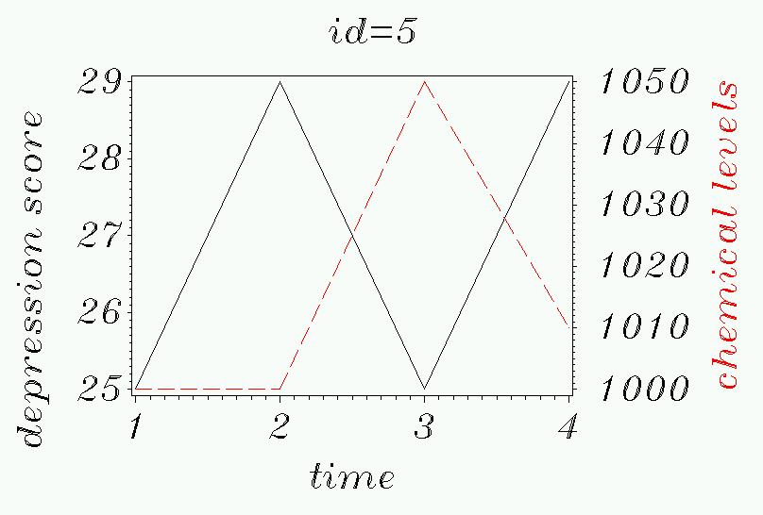

Slide 11
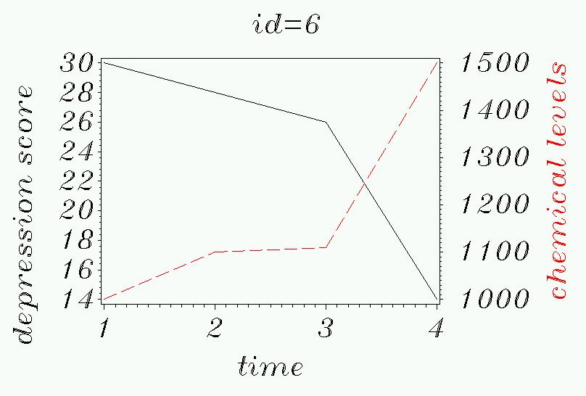

Slide 12
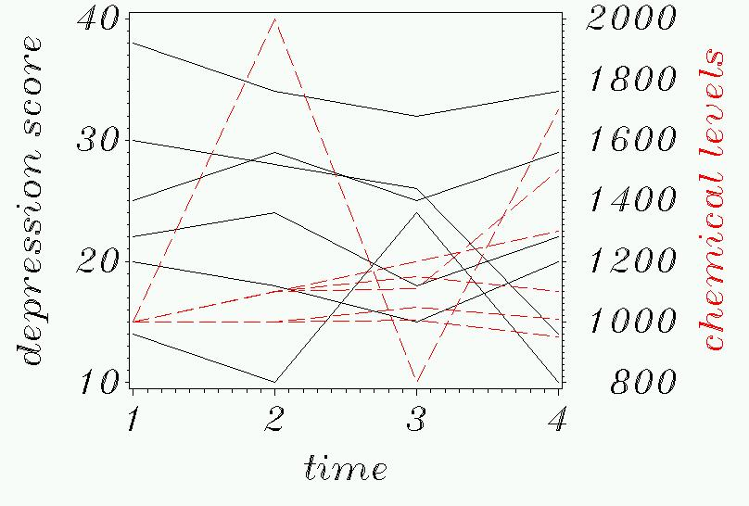
All 6 subjects at once:

Slide 13
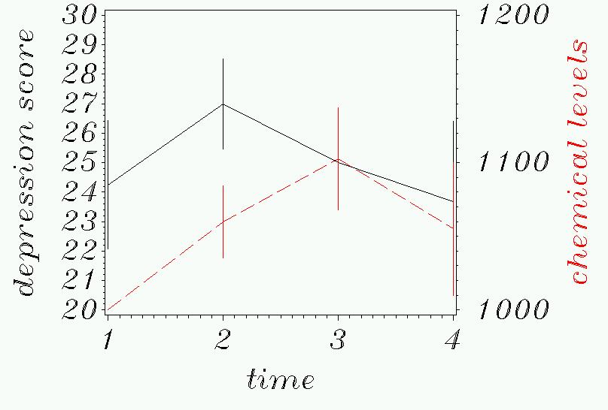
Mean chemical levels compared with mean depression scores:

Slide 14
How do you analyze these data?
Using repeated-measures ANOVA?
The only way to force a rANOVA here is…
data forcedanova;
set broad;
avgchem=(chem1+chem2+chem3+chem4)/4;
if avgchem<1100 then group="low";
if avgchem>1100 then group="high";
run;
proc glm data=forcedanova;
class group;
model time1-time4= group/ nouni;
repeated time /summary;
run; quit;
Gives no significant results!

Slide 15
How do you analyze these data?
We need more complicated models!
Today’s lecture:
Introduction to GEE for longitudinal data.
Introduction to Mixed models for longitudinal data.

Slide 16
But first…naïve analysis…
The data in long form could be naively thrown into an ordinary least squares (OLS) linear regression…
I.e., look for a linear correlation between chemical levels and depression scores ignoring the correlation between subjects. (the cheating way to get 4-times as much data!)
Can also look for a linear correlation between depression scores and time.
In SAS:
proc reg data=long;
model score=chem time;
run;

Slide 17
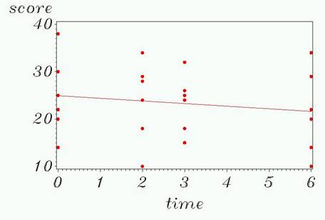
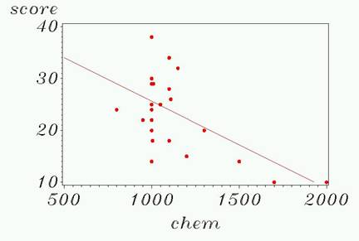
Graphically…
Naïve linear regression here looks for significant slopes (ignoring correlation between individuals):
Y= 24.90889 - 0.557778*time.
Y=42.44831-0.01685*chem
N=24—as if we have 24 independent observations!

Slide 18
The model
The linear regression model:

Slide 19
Results…
The fitted model:
Parameter Standard
Variable DF Estimate Error t Value Pr > |t|
Intercept 1 42.46803 6.06410 7.00 <.0001
chem 1 -0.01704 0.00550 -3.10 0.0054
time 1 0.07466 0.64946 0.11 0.9096
1-unit increase in chemical is associated with a .0174 decrease in depression score (1.7 points per 100 units chemical)
Each month is associated only with a .07 increase in depression score, after correcting for chemical changes.

Slide 20
Generalized Estimating Equations (GEE)
GEE takes into account the dependency of observations by specifying a “working correlation structure.”
Let’s briefly look at the model (we’ll return to it in detail later)…

Slide 21
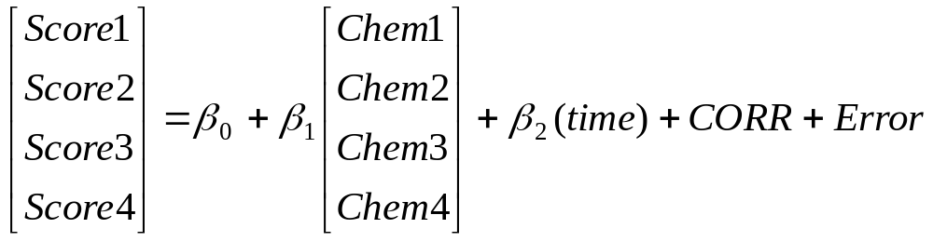
The model…
Measures linear correlation between chemical levels and depression scores across all 4 time periods. Vectors!
Measures linear correlation between time and depression scores.
CORR represents the correction for correlation between observations.
A significant beta 1 (chem effect) here would mean either that people who have high levels of chemical also have low depression scores (between-subjects effect), or that people whose chemical levels change correspondingly have changes in depression score (within-subjects effect), or both.

Slide 22
SAS code (long form of data!!)
Generalized Linear models (using MLE)…
proc genmod data=long4;
class id;
model score=chem time;
repeated subject = id / type=exch corrw; run; quit;
The type of correlation structure…
Time is continuous (do not place on class statement)!
Here we are modeling as a linear relationship with score.
NOTE, for time-dependent predictors…
--Interaction term with time (e.g. chem*time) is NOT necessary to get a within-subjects effect.
--Would only be included if you thought there was an acceleration or deceleration of the chem effect with time.

Slide 23
Results…
Analysis Of GEE Parameter Estimates
Empirical Standard Error Estimates
Standard 95% Confidence
Parameter Estimate Error Limits Z Pr > |Z|
Intercept 38.2431 4.9704 28.5013 47.9848 7.69 <.0001
chem -0.0129 0.0026 -0.0180 -0.0079 -5.00 <.0001
time -0.0775 0.2829 -0.6320 0.4770 -0.27 0.7841
In naïve analysis, standard error for time parameter was: 0.64946→ It’s cut by more than half here.
In Naïve analysis, the standard error for the chemical coefficient was 0.00550 → also cut in half here.

Slide 24
Effects on standard errors…
In general, ignoring the dependency of the observations will overestimate the standard errors of the the time-dependent predictors (such as time and chemical), since we haven’t accounted for between-subject variability.
However, standard errors of the time-independent predictors (such as treatment group) will be underestimated. The long form of the data makes it seem like there’s 4 times as much data then there really is (the cheating way to halve a standard error)!

Slide 25
What do the parameters mean?
Time has a clear interpretation: .0775 decrease in score per one-month of time (very small, NS).
It’s much harder to interpret the coefficients from time-dependent predictors:
  Between-subjects interpretation (different types of people): Having a 100-unit higher chemical level is correlated (on average) with having a 1.29 point lower depression score.
  Within-subjects interpretation (change over time): A 100-unit increase in chemical levels within a person corresponds to an average 1.29 point decrease in depression levels.
  **Look at the data: here all subjects start at the same chemical level, but have different depression scores. Plus, there’s a strong within-person link between increasing chemical levels and decreasing depression scores within patients (so likely largely a within-person effect).

Slide 26
How does GEE work?
First, a naive linear regression analysis is carried out, assuming the observations within subjects are independent.
Then, residuals are calculated from the naive model (observed-predicted) and a working correlation matrix is estimated from these residuals.
Then the regression coefficients are refit, correcting for the correlation. (Iterative process)
The within-subject correlation structure is treated as a nuisance variable (i.e. as a covariate)

Slide 27
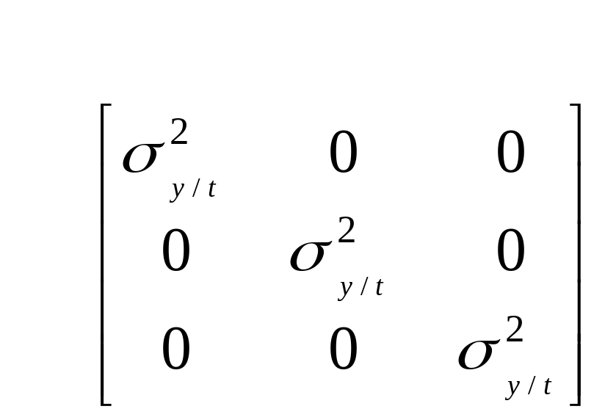
OLS regression variance-covariance matrix
t₁ t₂ t₃
Correlation structure (pairwise correlations between time points) is Independence.
t₁
t₂
t₃
Variance of scores is homogenous across time (MSE in ordinary least squares regression).

Slide 28
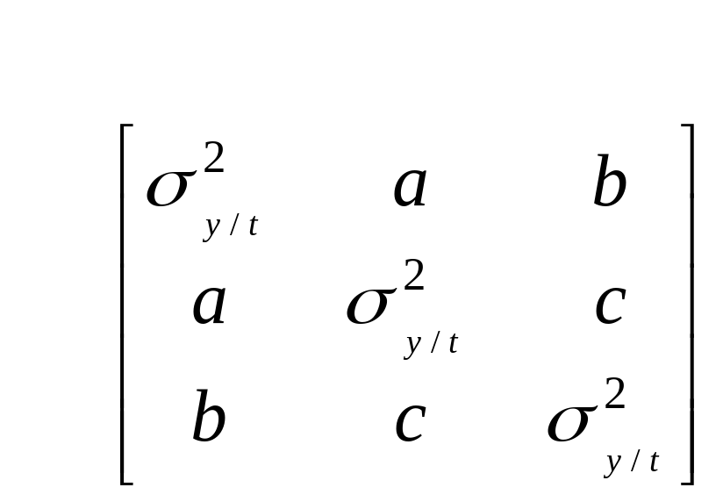
GEE variance-covariance matrix
t₁ t₂ t₃
Correlation structure must be specified.
t₁
t₂
t₃
Variance of scores is homogenous across time (residual variance).

Slide 29
Choice of the correlation structure within GEE
In GEE, the correction for within subject correlations is carried out by assuming a priori a correlation structure for the repeated measurements (although GEE is fairly robust against a wrong choice of correlation matrix—particularly with large sample size)
Choices:
  Independent (naïve analysis)
  Exchangeable (compound symmetry, as in rANOVA)
  Autoregressive
  M-dependent
  Unstructured (no specification, as in rMANOVA)
We are looking for the simplest structure (uses up the fewest degrees of freedom) that fits data well!

Slide 30
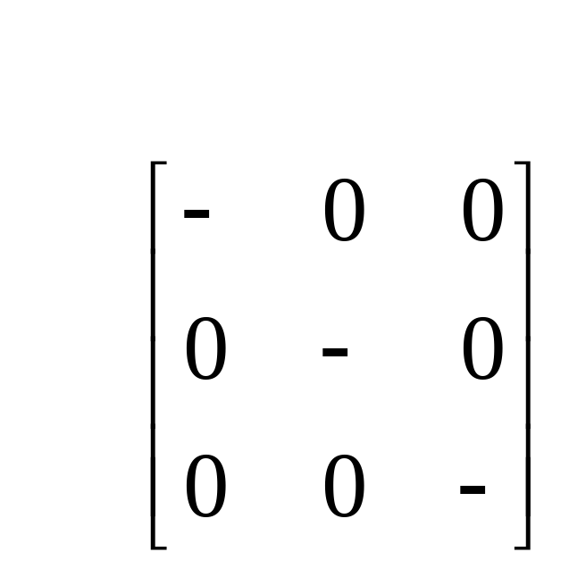
Independence
t₁ t₂ t₃
t₁
t₂
t₃

Slide 31
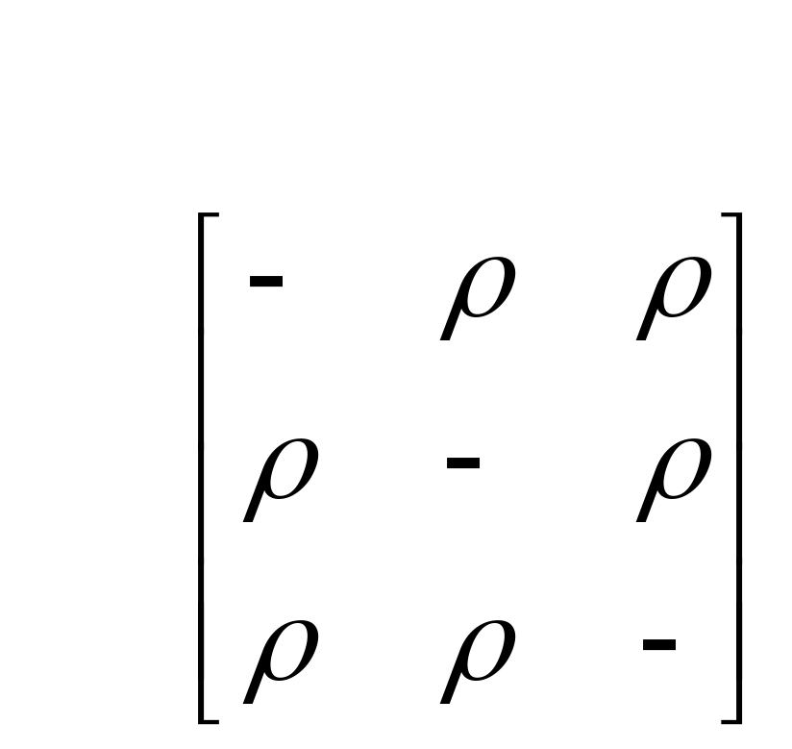
Exchangeable
t₁ t₂ t₃
t₁
t₂
t₃
Also known as compound symmetry or sphericity. Costs 1 df to estimate p.

Slide 32
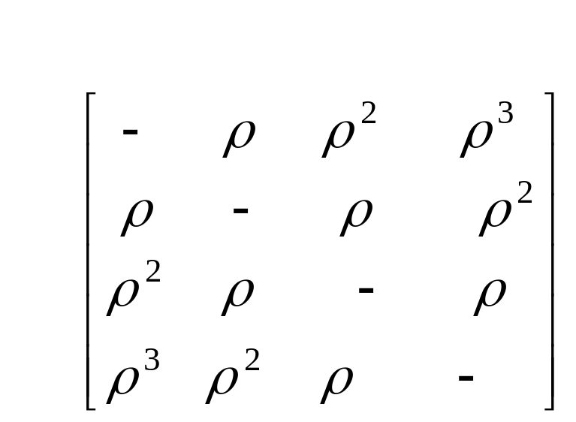
Autoregressive
t₁ t₂ t₃ t₄
t₁
t₂
t₃
t₄
Only 1 parameter estimated. Decreasing correlation for farther time periods.

Slide 33
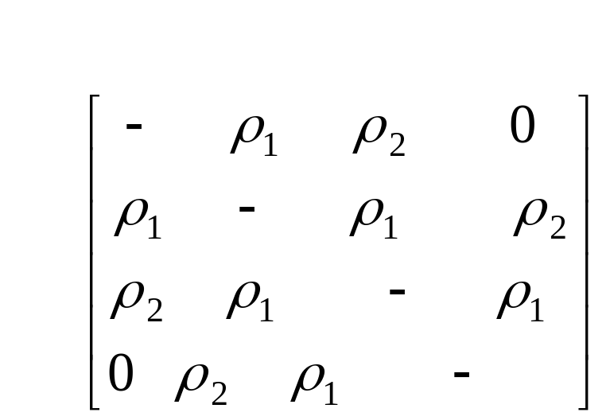
M-dependent
t₁ t₂ t₃ t₄
t₁
t₂
t₃
t₄
Here, 2-dependent. Estimate 2 parameters (adjacent time periods have 1 correlation coefficient; time periods 2 units of time away have a different correlation coefficient; others are uncorrelated)

Slide 34
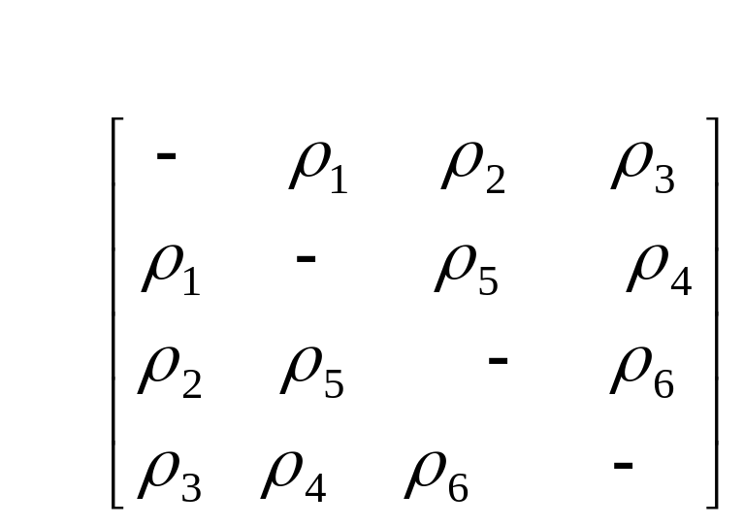
Unstructured
t₁ t₂ t₃ t₄
t₁
t₂
t₃
t₄
Estimate all correlations separately (here 6)

Slide 35
How GEE handles missing data
Uses the “all available pairs” method, in which all non-missing pairs of data are used in the estimating the working correlation parameters.
Because the long form of the data are being used, you only lose the observations that the subject is missing, not all measurements.

Slide 36
Back to our example…
What does the empirical correlation matrix look like for our data?
Pearson Correlation Coefficients, N = 6
Prob > |r| under H0: Rho=0
time1 time2 time3 time4
time1 1.00000 0.92569 0.69728 0.68635
0.0081 0.1236 0.1321
time2 0.92569 1.00000 0.55971 0.77991
0.0081 0.2481 0.0673
time3 0.69728 0.55971 1.00000 0.37870
0.1236 0.2481 0.4591
time4 0.68635 0.77991 0.37870 1.00000
0.1321 0.0673 0.4591
Independent?
Exchangeable?
Autoregressive?
M-dependent?
Unstructured?

Slide 37
Back to our example…
I previously chose an exchangeable correlation matrix…
proc genmod data=long4;
class id;
model score=chem time;
repeated subject = id / type=exch corrw; run; quit;
This asks to see the working correlation matrix.

Slide 38
Working Correlation Matrix
Working Correlation Matrix
Col1 Col2 Col3 Col4
Row1 1.0000 0.7276 0.7276 0.7276
Row2 0.7276 1.0000 0.7276 0.7276
Row3 0.7276 0.7276 1.0000 0.7276
Row4 0.7276 0.7276 0.7276 1.0000
Standard 95% Confidence
Parameter Estimate Error Limits Z Pr > |Z|
Intercept 38.2431 4.9704 28.5013 47.9848 7.69 <.0001
chem -0.0129 0.0026 -0.0180 -0.0079 -5.00 <.0001
time -0.0775 0.2829 -0.6320 0.4770 -0.27 0.7841

Slide 39
Compare to autoregressive…
proc genmod data=long4;
class id;
model score=chem time;
repeated subject = id / type=ar corrw;
run; quit;
Notes:
Kristin Sainani Ph.D.
http://www.stanford.edu/~kcobb
Stanford University
Department of Health Research and Policy

Slide 40
Working Correlation Matrix
Working Correlation Matrix
Col1 Col2 Col3 Col4
Row1 1.0000 0.7831 0.6133 0.4803
Row2 0.7831 1.0000 0.7831 0.6133
Row3 0.6133 0.7831 1.0000 0.7831
Row4 0.4803 0.6133 0.7831 1.0000
Analysis Of GEE Parameter Estimates
Empirical Standard Error Estimates
Standard 95% Confidence
Parameter Estimate Error Limits Z Pr > |Z|
Intercept 36.5981 4.0421 28.6757 44.5206 9.05 <.0001
chem -0.0122 0.0015 -0.0152 -0.0092 -7.98 <.0001
time 0.1371 0.3691 -0.5864 0.8605 0.37 0.7104

Slide 41
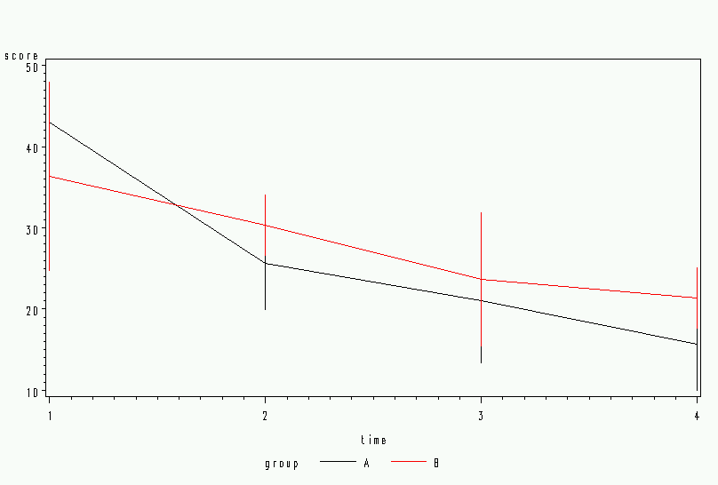
Example two…recall…
From rANOVA:
Within subjects effects, but no between subjects effects.
Time is significant.
Group*time is not significant.
Group is not significant.
This is an example with a binary time-independent predictor.

Slide 42
Empirical Correlation
Pearson Correlation Coefficients, N = 6
Prob > |r| under H0: Rho=0
time1 time2 time3 time4
time1 1.00000 -0.13176 -0.01435 -0.50848
0.8035 0.9785 0.3030
time2 -0.13176 1.00000 -0.02819 -0.17480
0.8035 0.9577 0.7405
time3 -0.01435 -0.02819 1.00000 0.69419
0.9785 0.9577 0.1260
time4 -0.50848 -0.17480 0.69419 1.00000
0.3030 0.7405 0.1260
Independent?
Exchangeable?
Autoregressive?
M-dependent?
Unstructured?

Slide 43
GEE analysis
proc genmod data=long;
class group id;
model score= group time group*time;
repeated subject = id / type=un corrw ;
run; quit;
NOTE, for time-independent predictors…
--You must include an interaction term with time to get a within-subjects effect (development over time).

Slide 44
Working Correlation Matrix
Working Correlation Matrix
Col1 Col2 Col3 Col4
Row1 1.0000 -0.0701 0.1916 -0.1817
Row2 -0.0701 1.0000 0.1778 -0.5931
Row3 0.1916 0.1778 1.0000 0.5931
Row4 -0.1817 -0.5931 0.5931 1.0000
Analysis Of GEE Parameter Estimates
Empirical Standard Error Estimates
Standard 95% Confidence
Parameter Estimate Error Limits Z Pr > |Z|
Intercept 42.1433 6.2281 29.9365 54.3501 6.77 <.0001
group A 7.8957 6.6850 -5.2065 20.9980 1.18 0.2376
group B 0.0000 0.0000 0.0000 0.0000 . .
time -4.9184 2.0931 -9.0209 -0.8160 -2.35 0.0188
time*group A -4.3198 2.1693 -8.5716 -0.0680 -1.99 0.0464
Group A is on average 8 points higher; there’s an average 5 point drop per time period for group B, and an average 4.3 point drop more for group A.
Comparable to within effects for time and time*group from rMANOVA and rANOVA

Slide 45
GEE analysis
proc genmod data=long;
class group id;
model score= group time group*time;
repeated subject = id / type=exch corrw ;
run; quit;

Slide 46
Working Correlation Matrix
Working Correlation Matrix
Col1 Col2 Col3 Col4
Row1 1.0000 -0.0529 -0.0529 -0.0529
Row2 -0.0529 1.0000 -0.0529 -0.0529
Row3 -0.0529 -0.0529 1.0000 -0.0529
Row4 -0.0529 -0.0529 -0.0529 1.0000
Analysis Of GEE Parameter Estimates
Empirical Standard Error Estimates
Standard 95% Confidence
Parameter Estimate Error Limits Z Pr > |Z|
Intercept 40.8333 5.8516 29.3645 52.3022 6.98 <.0001
group A 7.1667 6.1974 -4.9800 19.3133 1.16 0.2475
group B 0.0000 0.0000 0.0000 0.0000 . .
time -5.1667 1.9461 -8.9810 -1.3523 -2.65 0.0079
time*group A -3.5000 2.2885 -7.9853 0.9853 -1.53 0.1262
P-values are similar to rANOVA (which of course assumed exchangeable, or compound symmetry, for the correlation structure!)

Slide 47
Introduction to Mixed Models
Return to our chemical/score example.
Ignore chemical for the moment, just ask if there’s a significant change over time in depression score…

Slide 48
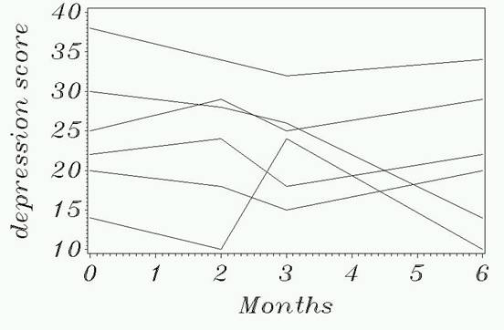
Introduction to Mixed Models
Return to our chemical/score example.

Slide 49
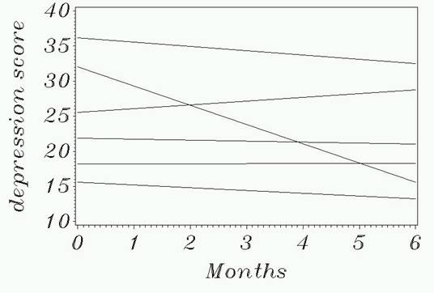
Introduction to Mixed Models
Linear regression line for each person…

Slide 50
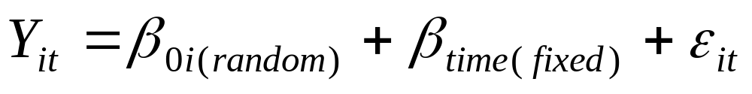
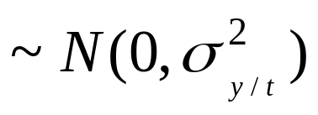
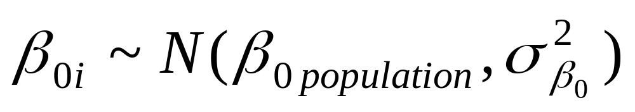
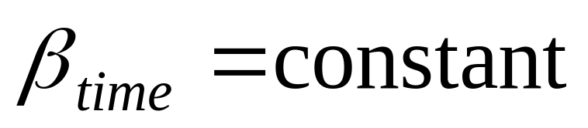
Introduction to Mixed Models
Mixed models = fixed and random effects. For example,
Residual variance:
Treated as a random variable with a probability distribution.
This variance is comparable to the between-subjects variance from rANOVA.
Two parameters to estimate instead of 1

Slide 51
Introduction to Mixed Models
What is a random effect?
--Rather than assuming there is a single intercept for the population, assume that there is a distribution of intercepts. Every person’s intercept is a random variable from a shared normal distribution.
--A random intercept for depression score means that there is some average depression score in the population, but there is variability between subjects.
Generally, this is a “nuisance parameter”—we have to estimate it for making statistical inferences, but we don’t care so much about the actual value.

Slide 52
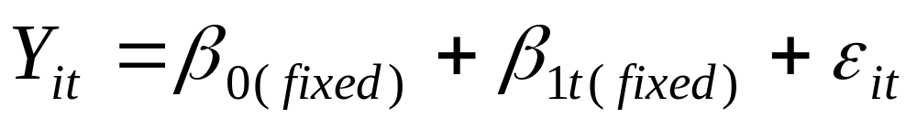
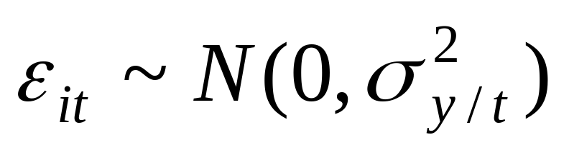
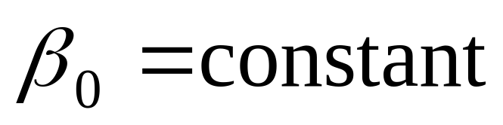
Compare to OLS regression:
Compare with ordinary least squares regression (no random effects):
Unexplained variability in Y.
LEAST SQUARES ESTIMATION FINDS THE BETAS THAT MINIMIZE THIS VARIANCE (ERROR)

Slide 53
RECALL, SIMPLE LINEAR REGRESSION:
The standard error of Y given T is the average variability around the regression line at any given value of T. It is assumed to be equal at all values of T.
σ_{y/t}
Y
σ _{y/t}
σ _{y/t}
σ _{y/t}
σ _{y/t}
σ _{y/t}
T

Slide 54
All fixed effects…
59.482929
3 parameters to estimate.
24.90888889
-0.55777778

Slide 55
The REG Procedure
Model: MODEL1
Dependent Variable: score
Analysis of Variance
Sum of Mean
Source DF Squares Square F Value Pr > F
Model 1 35.00056 35.00056 0.59 0.4512
Error 22 1308.62444 59.48293
Corrected Total 23 1343.62500
Root MSE 7.71252 R-Square 0.0260
Dependent Mean 23.37500 Adj R-Sq -0.0182
Coeff Var 32.99473
Parameter Estimates
Parameter Standard
Variable DF Estimate Error t Value Pr > |t|
Intercept 1 24.90889 2.54500 9.79 <.0001
time 1 -0.55778 0.72714 -0.77 0.4512
Where to find these things in OLS in SAS:

Slide 56
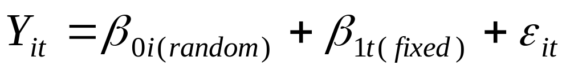
Introduction to Mixed Models
Adding back the random intercept term:

Slide 57
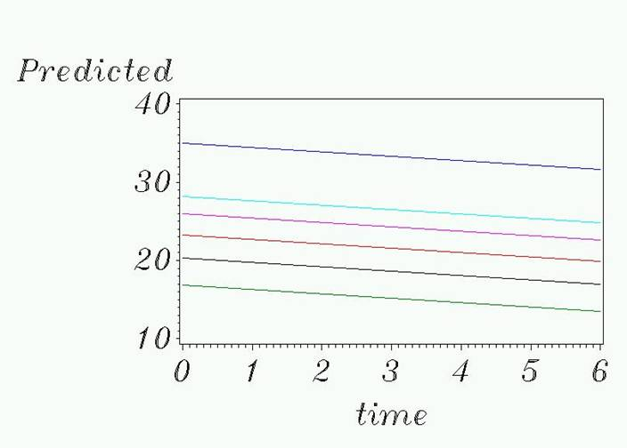
Meaning of random intercept
Mean population intercept
Variation in intercepts

Slide 58
Introduction to Mixed Models
Residual variance:18.9264
4 parameters to estimate.
Same:24.90888889
Variability in intercepts between subjects: 44.6121
Same:-0.55777778

Slide 59
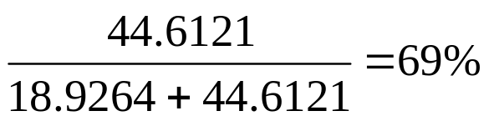
Covariance Parameter Estimates
Cov Parm Subject Estimate
Variance id 44.6121
Residual 18.9264
Fit Statistics
-2 Res Log Likelihood 146.7
AIC (smaller is better) 152.7
AICC (smaller is better) 154.1
BIC (smaller is better) 152.1
Solution for Fixed Effects
Standard
Effect Estimate Error DF t Value Pr > |t|
Intercept 24.9089 3.0816 5 8.08 0.0005
time -0.5578 0.4102 17 -1.36 0.1916
Where to find these things in from MIXED in SAS:
69% of variability in depression scores is explained by the differences between subjects
Interpretation is the same as with GEE: -.5578 decrease in score per month time.
Time coefficient is the same but standard error is nearly halved (from 0.72714)..

Slide 60
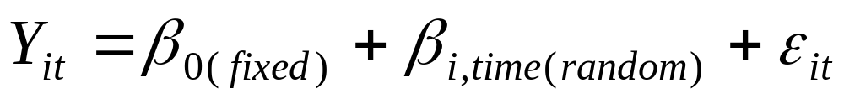
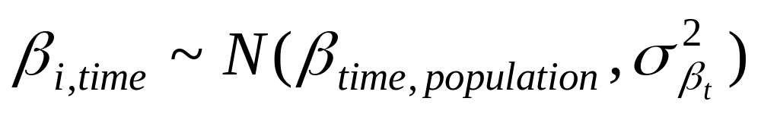
With random effect for time, but fixed intercept…
Allowing time-slopes to be random:

Slide 61
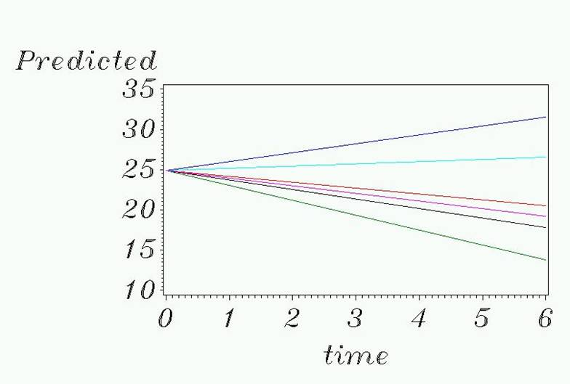
Meaning of random beta for time

Slide 62
With random effect for time, but fixed intercept…
Residual variance:40.4937
Same: 24.90888889
Variability in time slopes between subjects: 1.7052
Same:-0.55777778

Slide 63
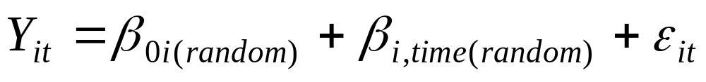
With both random…
With a random intercept and random time-slope:

Slide 64

Meaning of random beta for time and random intercept

Slide 65
With both random…
With a random intercept and random time-slope:
16.6311
Additionally, we have to estimate the covariance of the random intercept and random slope:
here -1.9943
(adding random time therefore cost us 2 degrees of freedom)
24.90888889
53.0068
0.55777778
0.4162

Slide 66
Choosing the best model
Aikake Information Criterion (AIC) : a fit statistic penalized by the number of parameters
AIC = - 2*log likelihood + 2*(#parameters)
Values closer to zero indicate better fit and greater parsimony.
Choose the model with the smallest AIC.

Slide 67
AICs for the four models
MODEL | AIC
All fixed | 162.2
Intercept random Time slope fixed | 150.7
Intercept fixed Time effect random | 161.4
All random | 152.7

Slide 68
In SAS…to get model with random intercept…
proc mixed data=long;
class id;
model score = time /s;
random int/subject=id;
run; quit;

Slide 69
Model with chem (time-dependent variable!)…
proc mixed data=long;
class id;
model score = time chem/s;
random int/subject=id;
run; quit;
Typically, we take care of the repeated measures problem by adding a random intercept, and we stop there—though you can try random effects for predictors and time.

Slide 70
Cov Parm Subject Estimate
Intercept id 35.5720
Residual 10.2504
Fit Statistics
-2 Res Log Likelihood 143.7
AIC (smaller is better) 147.7
AICC (smaller is better) 148.4
BIC (smaller is better) 147.3
Solution for Fixed Effects
Standard
Effect Estimate Error DF t Value Pr > |t|
Intercept 38.1287 4.1727 5 9.14 0.0003
time -0.08163 0.3234 16 -0.25 0.8039
chem -0.01283 0.003125 16 -4.11 0.0008
Residual and AIC are reduced even further due to strong explanatory power of chemical.
Interpretation is the same as with GEE: we cannot separate between-subjects and within-subjects effects of chemical.

Slide 71
New Example: time-independent binary predictor
From GEE:
Strong effect of time.
No group difference
Non-significant group*time trend.

Slide 72
SAS code…
proc mixed data=long ;
class id group;
model score = time group time*group/s corrb;
random int /subject=id ;
run; quit;

Slide 73
Results (random intercept)
Fit Statistics
-2 Res Log Likelihood 138.4
AIC (smaller is better) 142.4
AICC (smaller is better) 143.1
BIC (smaller is better) 142.0
Solution for Fixed Effects
Standard
Effect group Estimate Error DF t Value Pr > |t|
Intercept 40.8333 4.1934 4 9.74 0.0006
time -5.1667 1.5250 16 -3.39 0.0038
group A 7.1667 5.9303 16 1.21 0.2444
group B 0 . . . .
time*group A -3.5000 2.1567 16 -1.62 0.1242
time*group B 0 . . . .

Slide 74
Compare to GEE results…
Analysis Of GEE Parameter Estimates
Empirical Standard Error Estimates
Standard 95% Confidence
Parameter Estimate Error Limits Z Pr > |Z|
Intercept 40.8333 5.8516 29.3645 52.3022 6.98 <.0001
group A 7.1667 6.1974 -4.9800 19.3133 1.16 0.2475
group B 0.0000 0.0000 0.0000 0.0000 . .
time -5.1667 1.9461 -8.9810 -1.3523 -2.65 0.0079
time*group A -3.5000 2.2885 -7.9853 0.9853 -1.53 0.1262
Same coefficient estimates. Nearly identical p-values.
Mixed model with a random intercept is equivalent to GEE with exchangeable correlation…(slightly different std. errors in SAS because PROC MIXED additionally allows Residual variance to change over time.

Slide 75
Power of these models…
Since these methods are based on generalized linear models, these methods can easily be extended to repeated measures with a dependent variable that is binary, categorical, or counts…
These methods are not just for repeated measures. They are appropriate for any situation where dependencies arise in the data. For example,
  Studies across families (dependency within families)
  Prevention trials where randomization is by school, practice, clinic, geographical area, etc. (dependency within unit of randomization)
  Matched case-control studies (dependency within matched pair)
  In general, anywhere you have “clusters” of observations (statisticians say that observations are “nested” within these clusters.)
  For repeated measures, our “cluster” was the subject.
  In the long form of the data, you have a variable that identifies which cluster the observation belongs too (for us, this was the variable “id”)

Slide 76
References
Jos W. R. Twisk. Applied Longitudinal Data Analysis for Epidemiology: A Practical Guide. Cambridge University Press, 2003.

